Slide 1
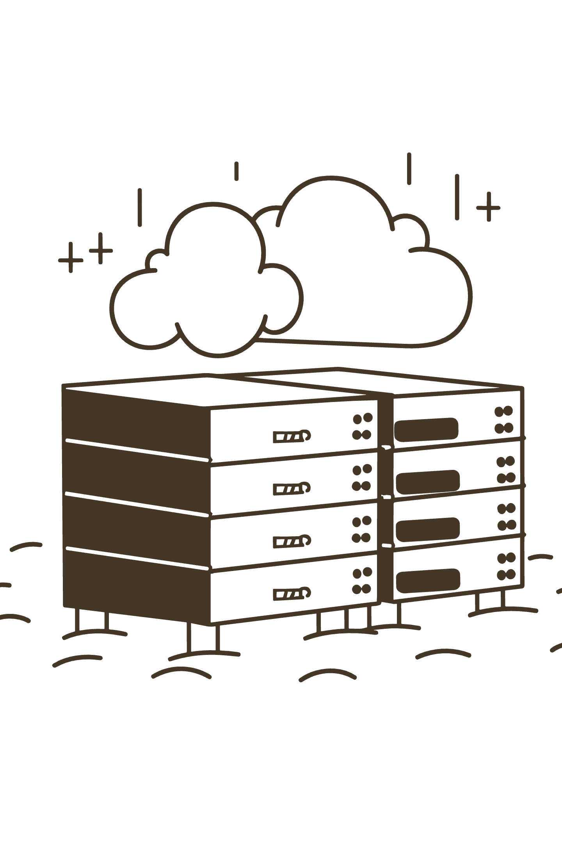
Interactive Digital Solution for Lab Capability Management
Presentation Outline for Digital Opportunity Manager

Slide 2

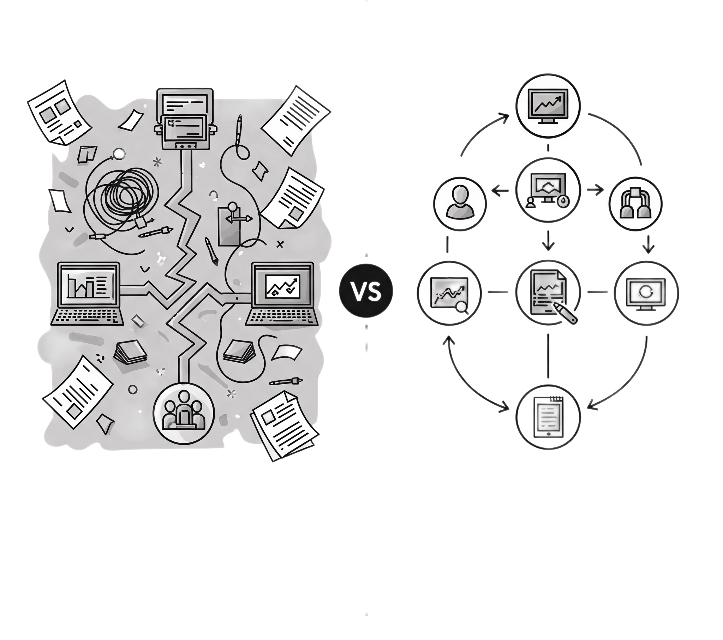




Current State: Efficiency Bottlenecks Costing Us Time & Money
Our lab operations face significant challenges due to fragmented processes, leading to lost time and unreliable data. Manual tasks and lack of centralized knowledge hinder efficiency and increase costs.
Project Time Loss
50% of project time lost in manual unit fitness testing.
Unreliable Data
SharePoint gaps create unreliable data (60-70% completeness).
Critical Stockouts
Critical spares stockouts cause unplanned downtime.
Manual QA
Manual quality assessments consume valuable scientist time.
Lost Knowledge
Lost institutional knowledge from past projects.

Slide 3
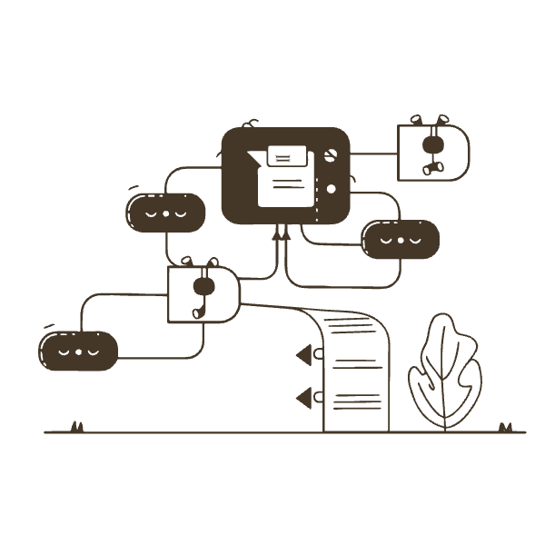
Proposed Solution: Custom Interactive Lab Management App
Our custom interactive lab management app is a centralized digital hub designed to streamline lab operations, improve data integrity, and leverage AI for enhanced efficiency and decision-making. It consolidates critical functions, replacing disparate systems and manual processes with an integrated, intelligent platform.
Centralized unit technical database: A single source of truth for equipment specs, calibration, maintenance, and performance, ensuring accuracy and accessibility.
AI-powered unit fitness recommendations: Proactive AI analysis provides recommendations for maintenance, optimal usage, and upgrades, minimizing downtime.
Automated quality assessment workflows: Streamlines QA from sample to results, reducing errors, accelerating turnaround, and freeing scientist time.
Smart inventory management with predictive alerts: Tracks consumables, reagents, and spares, generating alerts based on usage to prevent costly stockouts.
Integrated project history & learning database: Captures project data, designs, results, and lessons learned. This searchable knowledge base fosters collaboration and prevents past mistakes.

Slide 4
Measurable ROI: Clear Wins for Lab Operations
Implementing this solution will yield significant, quantifiable returns on investment, improving efficiency and reducing costs across key lab operations.
50%
60%
90%
Time Reduction
QA Effort
Stockout Reduction
Reduction in project fitness testing time (4-8 hrs → <1 hr).
Reduction in manual QA effort.
Reduction in critical spares stockouts.
98%
15%
Inventory Accuracy
Lab Throughput
Inventory accuracy (vs. current 70-80%).
Increase in overall lab throughput.

Slide 5



Why Custom Solution Beats Current SharePoint Approach
SharePoint Limitations:
Poor search functionality → "fruitless searches"
Data integrity risks → conflicting edits, version control issues
Limited analytics → reactive vs. proactive management
Escalating costs → customization complexity
Our Solution Benefits:
Structured data integrity from ground up
Intelligent search & AI recommendations
Predictive insights for maintenance & resource allocation
Cost-controlled internal development

Slide 6

Leveraging Internal Expertise for Cost-Effective Delivery
Our internal capabilities and chosen technology stack ensure a cost-effective and user-centric development process, tailored specifically to lab operations.
Technology Approach:
Database: PostgreSQL (robust, open-source)
Backend: Python (Flask/FastAPI)
Frontend: Streamlit/Dash (rapid development)
AI/ML: Standard Python libraries (Pandas, Scikit-learn)
Internal Capability Advantage:
Lab experimentalist perspective = user-centric design
Python/VBA skills = custom data migration & integrations
Domain expertise = no learning curve on lab operations
Cost advantage = internal development vs. external consulting

Slide 7
Low-Risk, High-Value Delivery Approach
Our phased implementation roadmap ensures a controlled, iterative development process, delivering value at each stage while minimizing risk.
Phase 1 (2-3 months)
1
Planning & Data Foundation: Requirements, database design, data migration scripts.
2
Phase 2 (3-5 months)
MVP Development: Core unit management, project tracking, basic inventory.
Phase 3 (4-6 months)
3
AI/ML & Automation: Unit fitness recommendations, automated QA, predictive maintenance.
4
Phase 4 (Ongoing)
Optimization & Continuous Improvement: Full deployment, training, iterative enhancements.

Slide 8




Proven Strategy: Leading Organizations Already Achieving Results
This digital transformation is not experimental; it's a proven strategy adopted by industry leaders to enhance efficiency and decision-making in lab operations.
Merck
Pharmaceutical Company
20% improvement in production uptime with predictive analytics.
8% more out-of-specification results detected with automated data management.
Novartis
NIH Strategic Plan
Digital twins for resource allocation optimization.
Emphasizes automated metadata collection and enhanced data discovery.

Slide 9
Call to Action: Sponsor Phase 1 to Begin Transformation
We request approval and resources for Phase 1 to lay the foundation for this transformative digital solution. This initial phase will deliver critical documents and validate our technology stack.
Immediate Request:
Expected Phase 1 Deliverables (2-3 months):
Approval for Phase 1 (Planning & Data Foundation)
Detailed requirements document
Resource allocation for requirements gathering and technology setup
Database schema design
Data migration scripts (initial version)
Support for stakeholder engagement across lab teams
Technology stack setup and validation
Next Meeting: Present Phase 1 results and seek approval for MVP development.
Click here to access full report

